Slide 1

Smart Traffic AI: Revolutionizing Urban Mobility
The future of traffic management is here. Smart Traffic AI leverages the power of artificial intelligence to create safer, more efficient, and sustainable roads for everyone. i. Joseph Kirika - SCT211-0061/2022
ii. Irke Konzolo - SCT211-0081/2022
iii. Felix Ombongi - SCT211-0017/2022
iv. Allan Canon - SCT211-0019/2020
v. Derrick Gacheru - SCT211-0004/2021
vi.John Kibet - SCT211-0455/2022

Slide 2
The Problem: Today's Traffic Challenges
Economic Costs
Time Wasted
Environmental Impact
Safety Concerns
Urban congestion costs are a significant burden on the economy. Traffic congestion in Kenya, especially in Nairobi, leads to significant economic losses. Billions of shillings are lost annually due to wasted fuel, lost productivity, and vehicle maintenance costs. Poor infrastructure and rapid urbanization contribute to the worsening traffic situation.
In Nairobi, commuters spend an average of 3-5 hours daily in traffic, reducing productivity. This leads to economic losses and increased stress levels among workers. Poor road networks and overcrowding worsen the situation.
Traffic congestion leads to increased emissions and fuel consumption, contributing to air pollution and climate change.
Higher accident rates are prevalent in congested areas, putting drivers and pedestrians at risk.

Slide 3
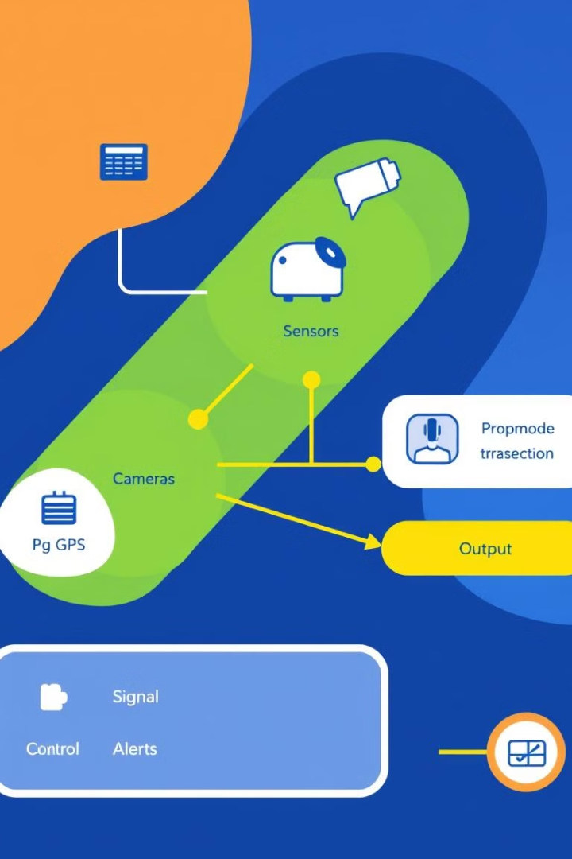
Introducing Smart Traffic AI: The Solution
1
Real-time Traffic Analysis
Smart Traffic AI utilizes AI algorithms to analyze and predict traffic conditions in real-time, providing a comprehensive understanding of traffic flow.
2
Adaptive Signal Control
AI-powered adaptive traffic signal control optimizes signal timings based on real-time conditions, reducing delays and improving traffic flow.
3
Incident Detection and Response
The system automatically detects accidents, road closures, and other incidents, enabling rapid response and minimizing disruptions.
4
Proactive Congestion Management
Smart Traffic AI proactively identifies potential congestion points and implements strategies to prevent or mitigate them.

Slide 4

Key Features: Intelligent Traffic Management
Adaptive Signal Timing
Predictive Modeling
Adjusts signal timings based on real-time conditions, reducing delays by up to 25% (Source: US DOT studies).
Forecasts traffic patterns to proactively manage congestion before it occurs.
Incident Detection
Dynamic Routing
Automatically identifies accidents and unusual traffic patterns, reducing response times by 30% (Source: ITS America).
Provides drivers with real-time route optimization to avoid congested areas.

Slide 5





Benefits: Quantifiable Improvements
Reduced Congestion
Decreased Emissions
Improved Safety
Enhanced Emergency Response
Smart Traffic AI can reduce congestion and travel times by 20-40%, making commutes faster and more efficient.
By reducing idling and optimizing traffic flow, Smart Traffic AI decreases fuel consumption and emissions by 10-15%, contributing to a cleaner environment.
Smart Traffic AI enhances safety by reducing accidents by 15-20%, creating a safer environment for drivers and pedestrians.
The system provides real-time traffic data to emergency services, optimizing their routes and improving response times.

Slide 6

AI and Machine Learning: How It Works
Data Collection
1
Smart Traffic AI gathers data from a variety of sources, including traffic cameras, sensors, and GPS-enabled devices.
2
Machine Learning Algorithms
Machine learning algorithms are trained on historical traffic data to predict future conditions and optimize traffic flow.
Neural Networks
3
Neural networks analyze real-time traffic data and adjust signal timings to optimize traffic flow and minimize delays.
4
Continuous Learning
The system continuously learns and adapts based on new data, improving its accuracy and effectiveness over time.

Slide 7
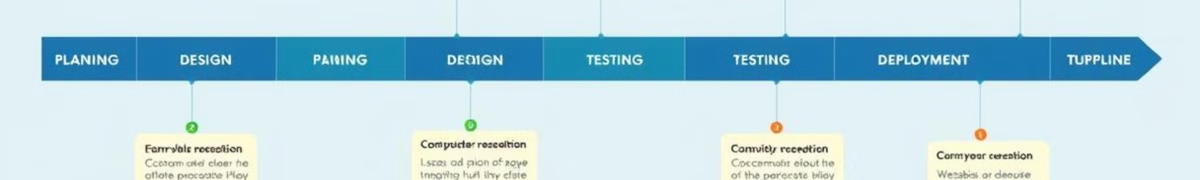




Implementation: Seamless Integration
Modular Design
Smart Traffic AI has a modular design, making it easy to integrate with existing traffic infrastructure.
Cloud-based Platform
The system is cloud-based, enabling centralized management and scalability for large-scale deployments.
Industry Partnerships
Smart Traffic AI collaborates with leading hardware and software providers to ensure seamless integration and compatibility.
Phased Rollout
The system is implemented in a phased approach, minimizing disruption and ensuring a smooth transition.

Slide 8
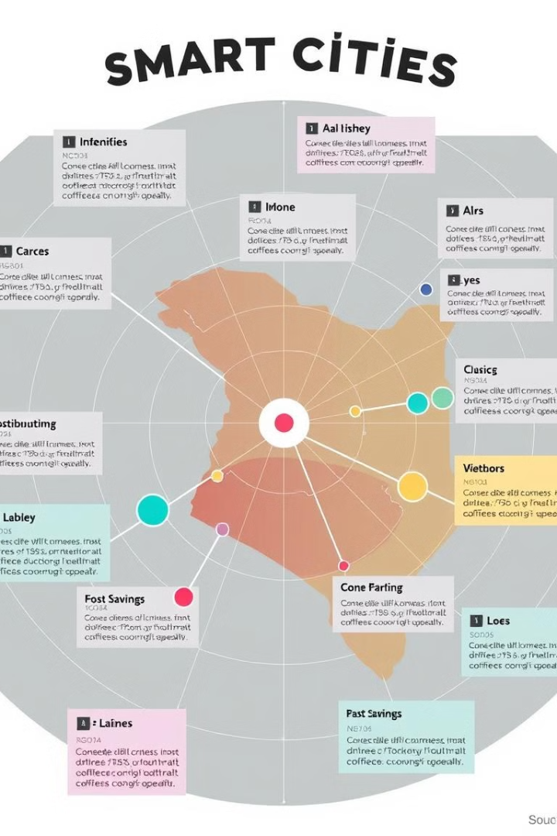
Case Studies: Success Stories
City A
Reduced congestion by 30% and accidents by 18% after implementing Smart Traffic AI.
City B
Improved air quality by 12% due to reduced idling and emissions.
City C
Saved $5 million annually in fuel costs and productivity gains.

Slide 9




The Future of Smart Traffic
Autonomous Vehicles
1
Smart Traffic AI will seamlessly integrate with autonomous vehicles, creating a more efficient and safe transportation system.
Smart City Initiatives
2
The system will play a key role in smart city initiatives, connecting traffic management with other urban systems.
Personalized Traffic Information
3
Drivers will receive personalized traffic information and route guidance, optimizing their commutes and reducing congestion.
Enhanced Public Transportation
4
Smart Traffic AI will prioritize public transportation, ensuring efficient and reliable service for all commuters.

Slide 10

Invest in Smart Traffic AI: Drive the Future of Mobility
Smart Traffic AI is transforming cities around the world, creating safer, more efficient, and sustainable transportation systems for everyone. Contact us today to learn how Smart Traffic AI can revolutionize your city's mobility and drive a brighter future.

